Slide 1
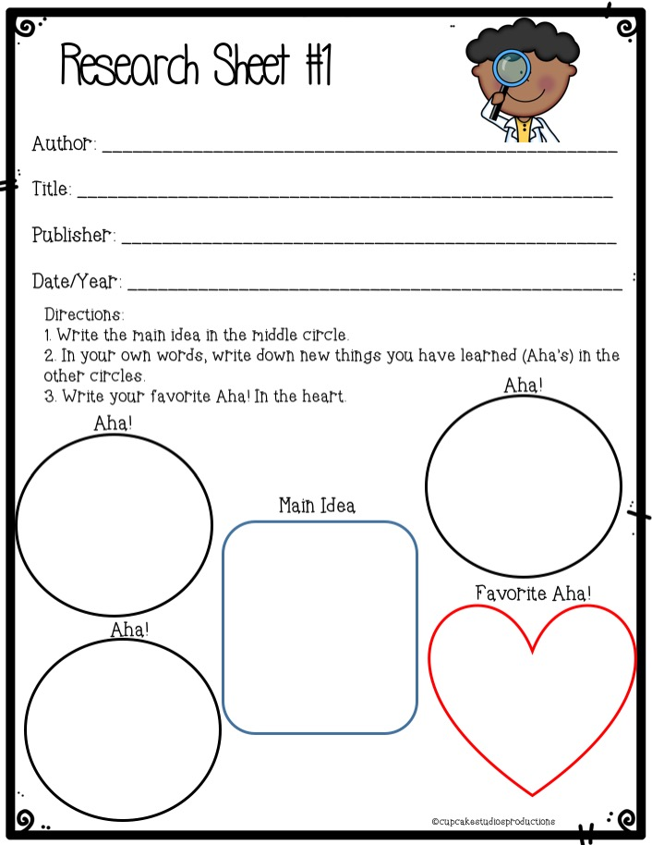
Enchanted Learning
“The US Penny”
Enchanted Learning
N/A
Website Address: https://www.enchantedlearning.com/math/money/coins/penny/
Thickness: 1.55 mm
Diameter: 19.05mm
This text talks about the history of pennies as well as pennies that are used today.
The first penny was created by Benjamin Franklin.
The first penny ever created was made using copper.

Slide 2
Website Address:

Slide 3
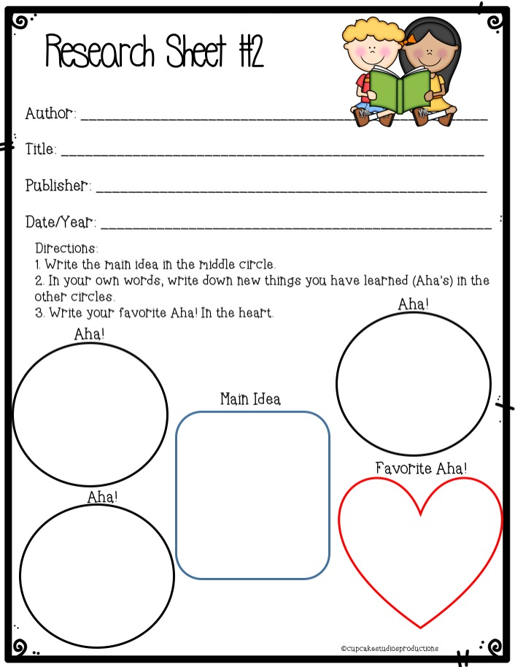
Website Address:

Slide 4
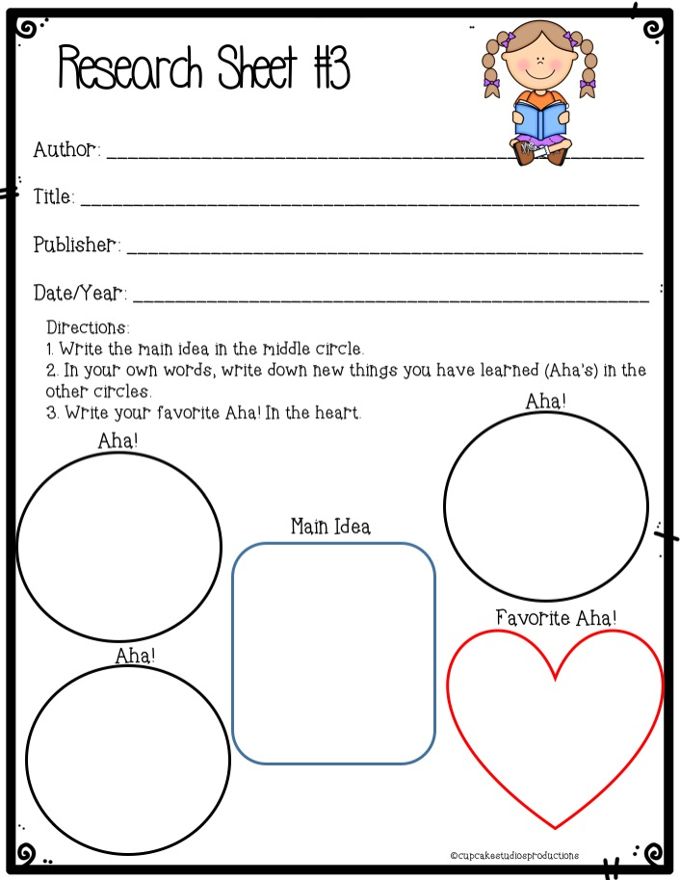
Website Address:

